Slide 1
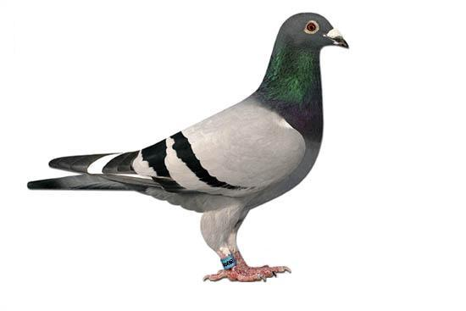
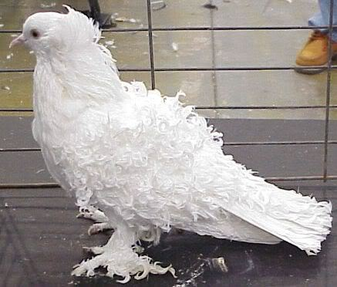
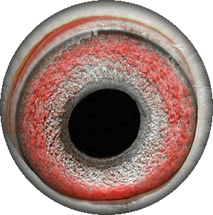
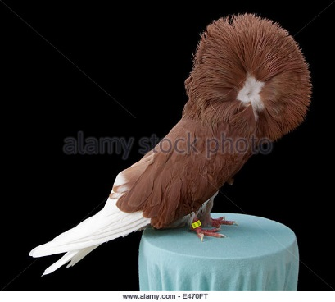
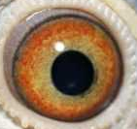
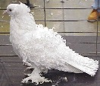
Ashton’s Pigeon Company
Featured Pigeons
Navigation
Welcome to Ashton’s Pigeon Company! At Ashton’s Pigeon Company we really appreciate pigeons and like to see pigeons. Please use the links to the left to search, browse, and add new pigeons to Ashton’s Pigeon Company.
Our featured pigeons are chosen each month from submissions blah blah blah.
Name: Curly
Age: 32
Search Pigeons
Browse Pigeons
Add New Pigeon
Name: Busty
Age: 1

